Slide 1

What makes a movie popular?
Data Analysis and Visualization
By Jason Long

Slide 2
Methodology
Data set of 5000 movies given a “Popularity Score” based on votes received at tmdb.com
Data set found at Kaggle.com here
Clean data (remove data about individual movie websites, taglines, synopses, etc.)
Remove outliers in numerical data (i.e. movies voted on 1 time with high scores, movies receiving an abnormally large number of total votes, etc.)
Define a “Hit Movie” as any that received a popularity score in the top 15% of all scores
Result: 661 movies classified as “Hits”

Slide 3
findings
If you want to make a hit movie…
MAKE IT WITH ENGLISH AS THE ORIGINAL LANGUAGE!
97% of those classified as Hits are in English

Slide 4
MORE FINDINGS
If you want to make a hit movie…
HAVE IT PRODUCED IN THE
UNITED STATES!
68% of those classified as Hits are produced in the United States

Slide 5
More Findings
If you want to make a hit movie…
HAVE IT PRODUCED BY A MAJOR STUDIO!
Almost half of those classified as Hit Movies were made by a studio in the top 10 in US market share.
STUDIO NAME | POPULAR MOVIE COUNT | STUDIO US MARKET SHARE RANK | STUDIO HEADQUARTERS LOCATION
Universal Pictures/DreamWorks SKG | 76 | 1 | Universal City, California
Columbia Pictures/Columbia Pictures Corporation (Sony) | 62 | 5 | Culver City, California
Paramount Pictures/Miramax Films | 55 | 3 | Los Angeles, California
New Line Cinema/Warner Bros | 40 | 4 | Burbank, California
Twentieth Century Fox Film Corporation | 36 | 6 | Los Angeles, California
Walt Disney Pictures | 19 | 2 | Burbank, California
Summit Entertainment (Lionsgate) | 15 | 10 | Santa Monica, California
United Artists | 15 | 9 | Beverly Hills, California
Village Roadshow Pictures | 10 | NR | Los Angeles, California
Market share data found at: https://www.the-numbers.com/market/2022/distributors

Slide 6
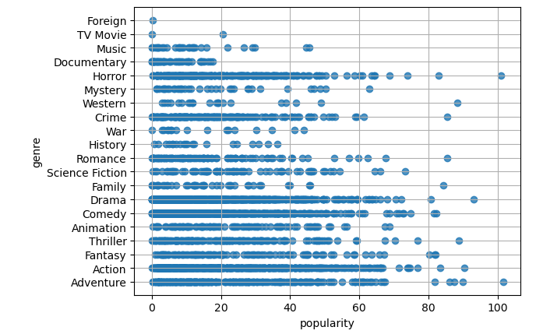
findings
If you want to make a hit movie…
Stick to one of these genres:
Action Comedy Drama Adventure
Horror Thriller Animation
Fantasy Sci-Fi Romance
And avoid these:
Foreign Documentary
0 Foreign Films or Documentaries were
classified as Hit Movies!

Slide 7

Think you can make the next hit movie?
Then take it to…

